Slide 1

Banking – KYC Process Automation
A Hackathon Solution by KYC Nexus

Slide 2
The Challenge: Manual KYC Onboarding
The Process:
The Problems:
Banks currently navigate a complex, manual labyrinth of document collection, in-person verification, and multi-level approvals to comply with Know Your Customer (KYC) regulations. This traditional approach is outdated and unsustainable in today's fast-paced digital economy.
Slow for Customers
Risky for Banks
Inefficient for Employees

Slide 3

Our Solution: IntelliKYC on ServiceNow
1
2
Seamless Digital Onboarding
Intelligent Automation & Risk Scoring
A fully integrated portal and chatbot experience that guides customers effortlessly through the initial application process.
Automated, real-time risk assessment for every applicant, significantly reducing manual review time and enhancing accuracy.
3
4
Dynamic, Risk-Based Workflows
Real-Time Transparency for All
Automated routing of applications based on risk profiles, ensuring efficient and compliant multi-level approvals.
Instant status updates for customers and internal teams, providing clarity and reducing inquiry volumes.
5
6
Conversational AI Support
Complete Auditability & Compliance
Guided submission and immediate support via Virtual Agent, enhancing user experience and reducing call center load.
A permanent, immutable audit trail of every decision and action, ensuring regulatory adherence and simplified reporting.

Slide 5
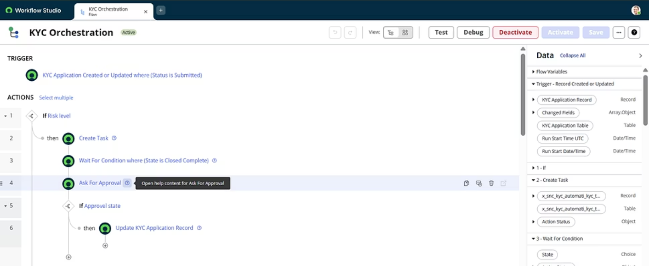
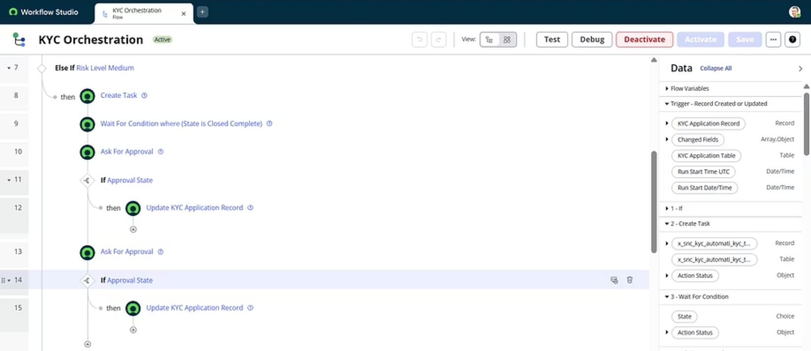
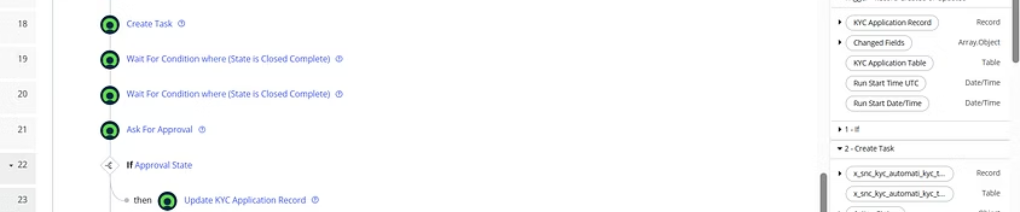
Flow Designer: KYC Orchestration

Slide 6
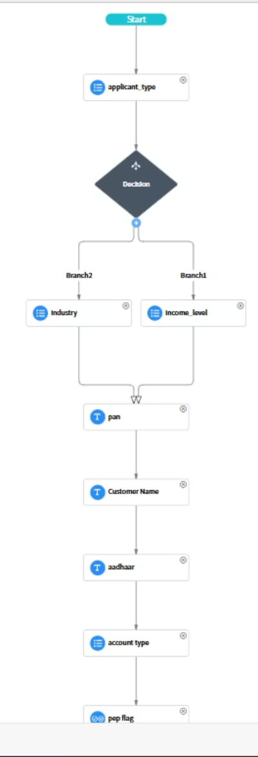
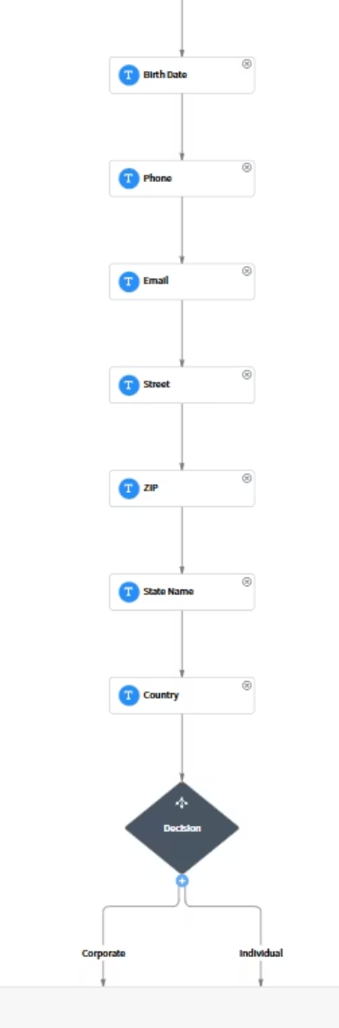
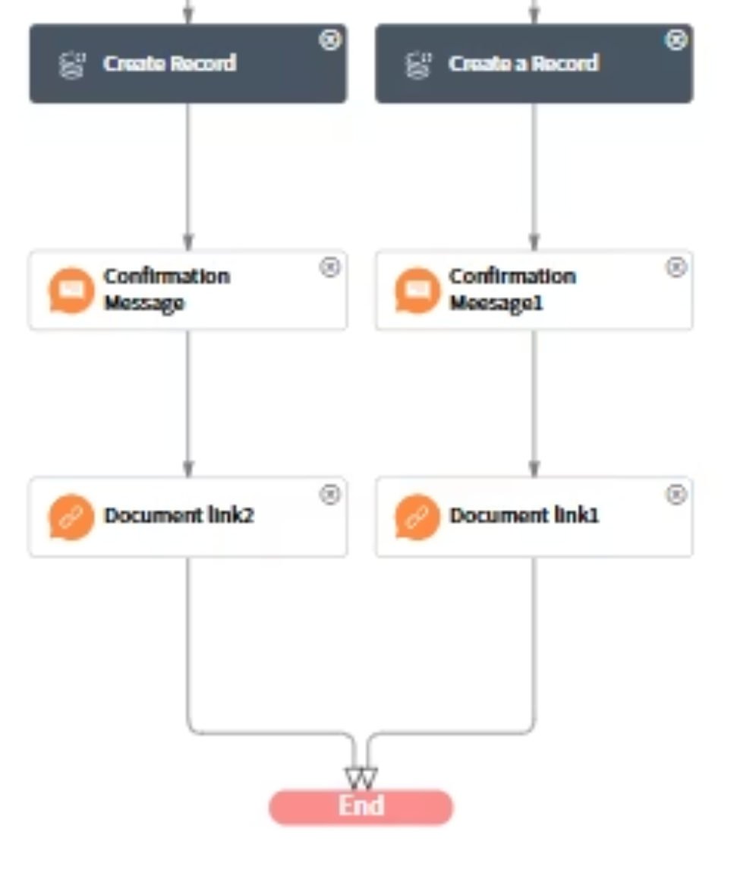
Check KYC Status
Submit KYC Application
Virtual Agent Designer (Topics)

Slide 7
IntelliKYC: The complete onboarding solution
Key Outcomes:
Turnaround Time Reduced from Days to Hours.
Enhanced Customer Experience via Conversational AI.
Improved Agent Productivity with Guided Workspaces.
Full Compliance and End-to-End Auditability.

